Slide 1

USER GUIDE
For the smart vest system for blind people

Slide 2
Turning on the vest
Remove the microSD card, put into computer, locate this file
2.Change the wifi address and password to your own wifi address and password
3,Turn on the powerbank attached to the vest, it will connect to the wifi automatically.
/etc/wpa_supplicant/wpa_supplicant.conf.

Slide 3
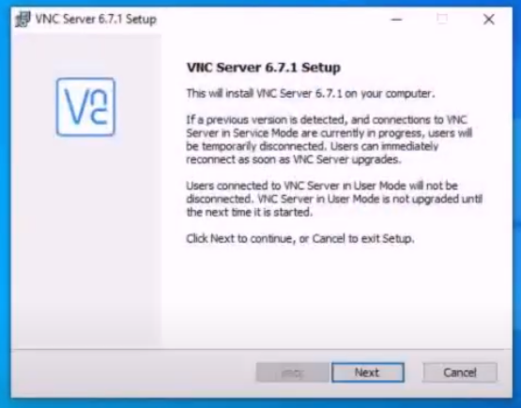
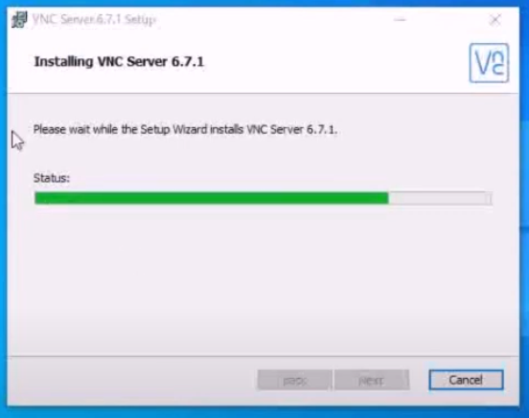
1. Installing REAL VNC viewer in the computer
. A free version of the app is available on the official website https://www.realvnc.com/en/connect/download/viewer/. After the extension is downloaded, the installation setup is guided by a wizard as shown

Slide 4
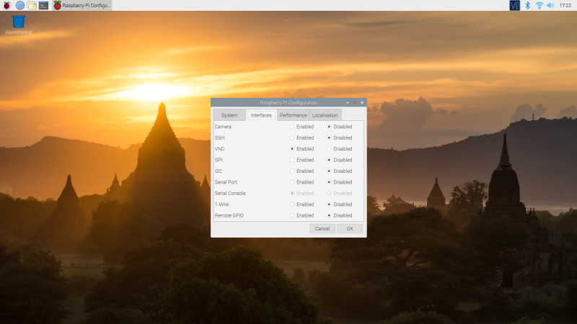
click the applications menu icon (raspberry) at the top-left of the screen and select Preferences > Raspberry Pi Configuration.
Then enable VNC

Slide 5
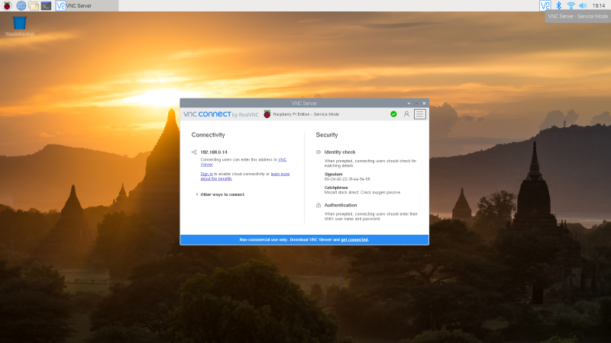
VNC connectivity window will show up

Slide 6
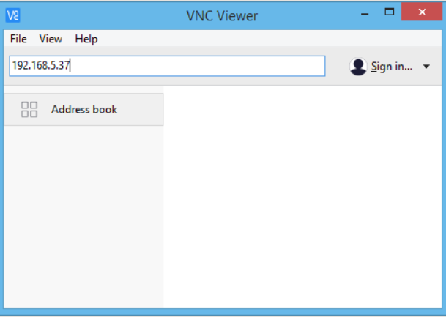
PUT the IP of the raspberry pi, you find in in the router admin app provided by your ISP.

Slide 7
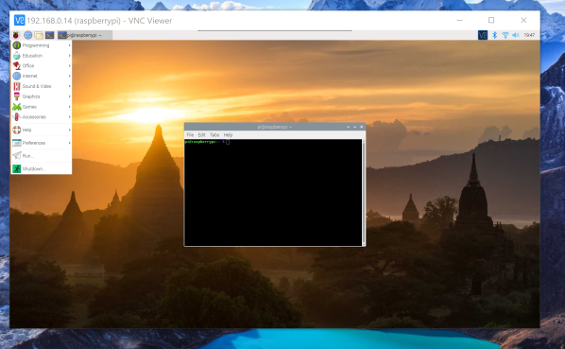
The terminal of the raspberry pi will show up

Slide 8
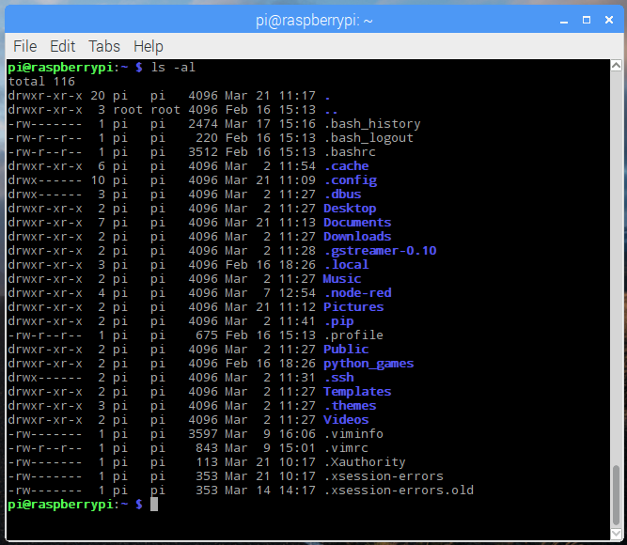
Now u need to list all the directories, by the following command: ls –al and run the code file

Slide 9
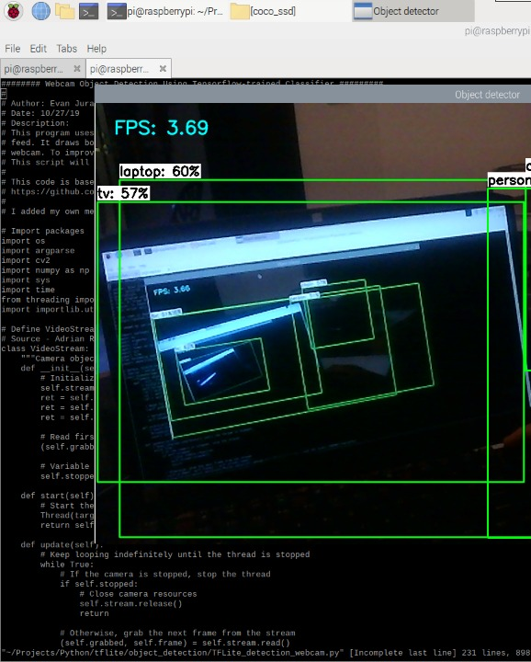
Once you run the code, the vest will start measuring distance, at one meter close object is detected, image processing will start and object names will be given to the vest wearer as audio output in headphones.

